Slide 1
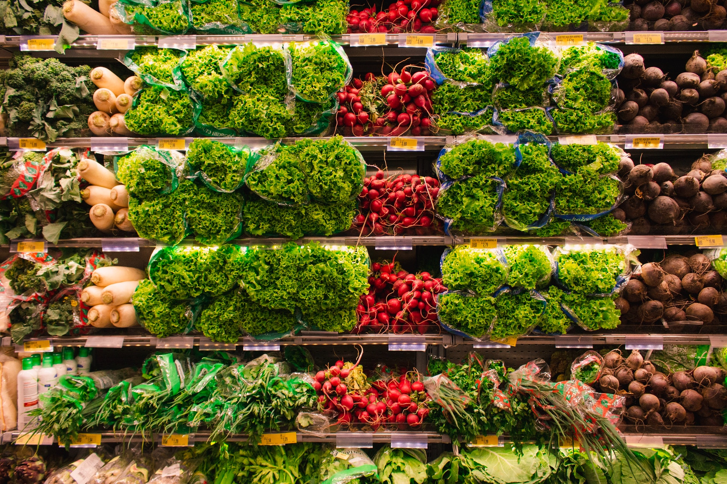
Should we apply Deep Learning?

Slide 2
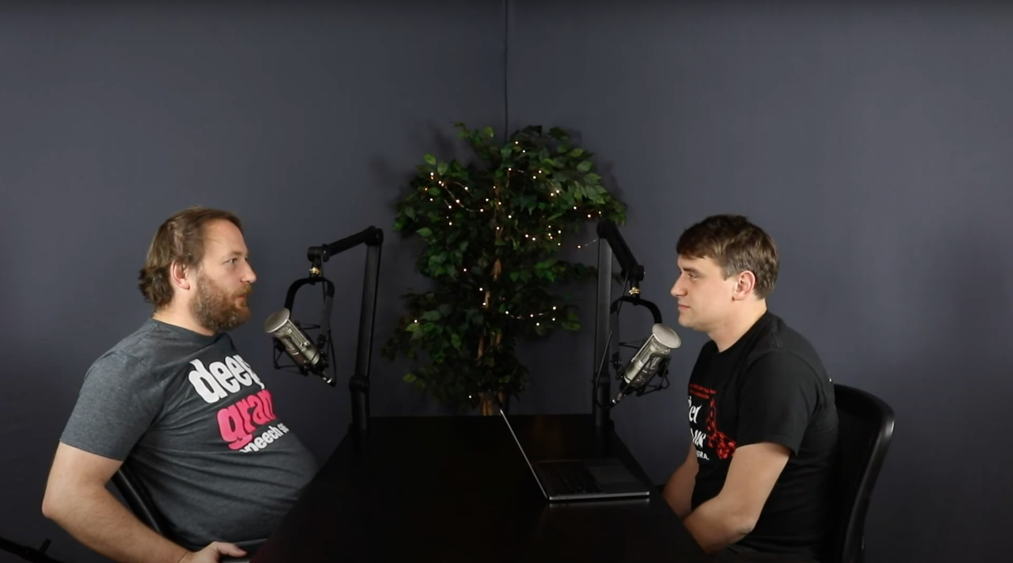
Only Deep Learning after trying classic approach first
"You would be surprised what the most basic algorithms can do"
What are the top mistakes in Deep Learning? — AI Show
https://www.youtube.com/watch?v=4G80eRhXRHE

Slide 3
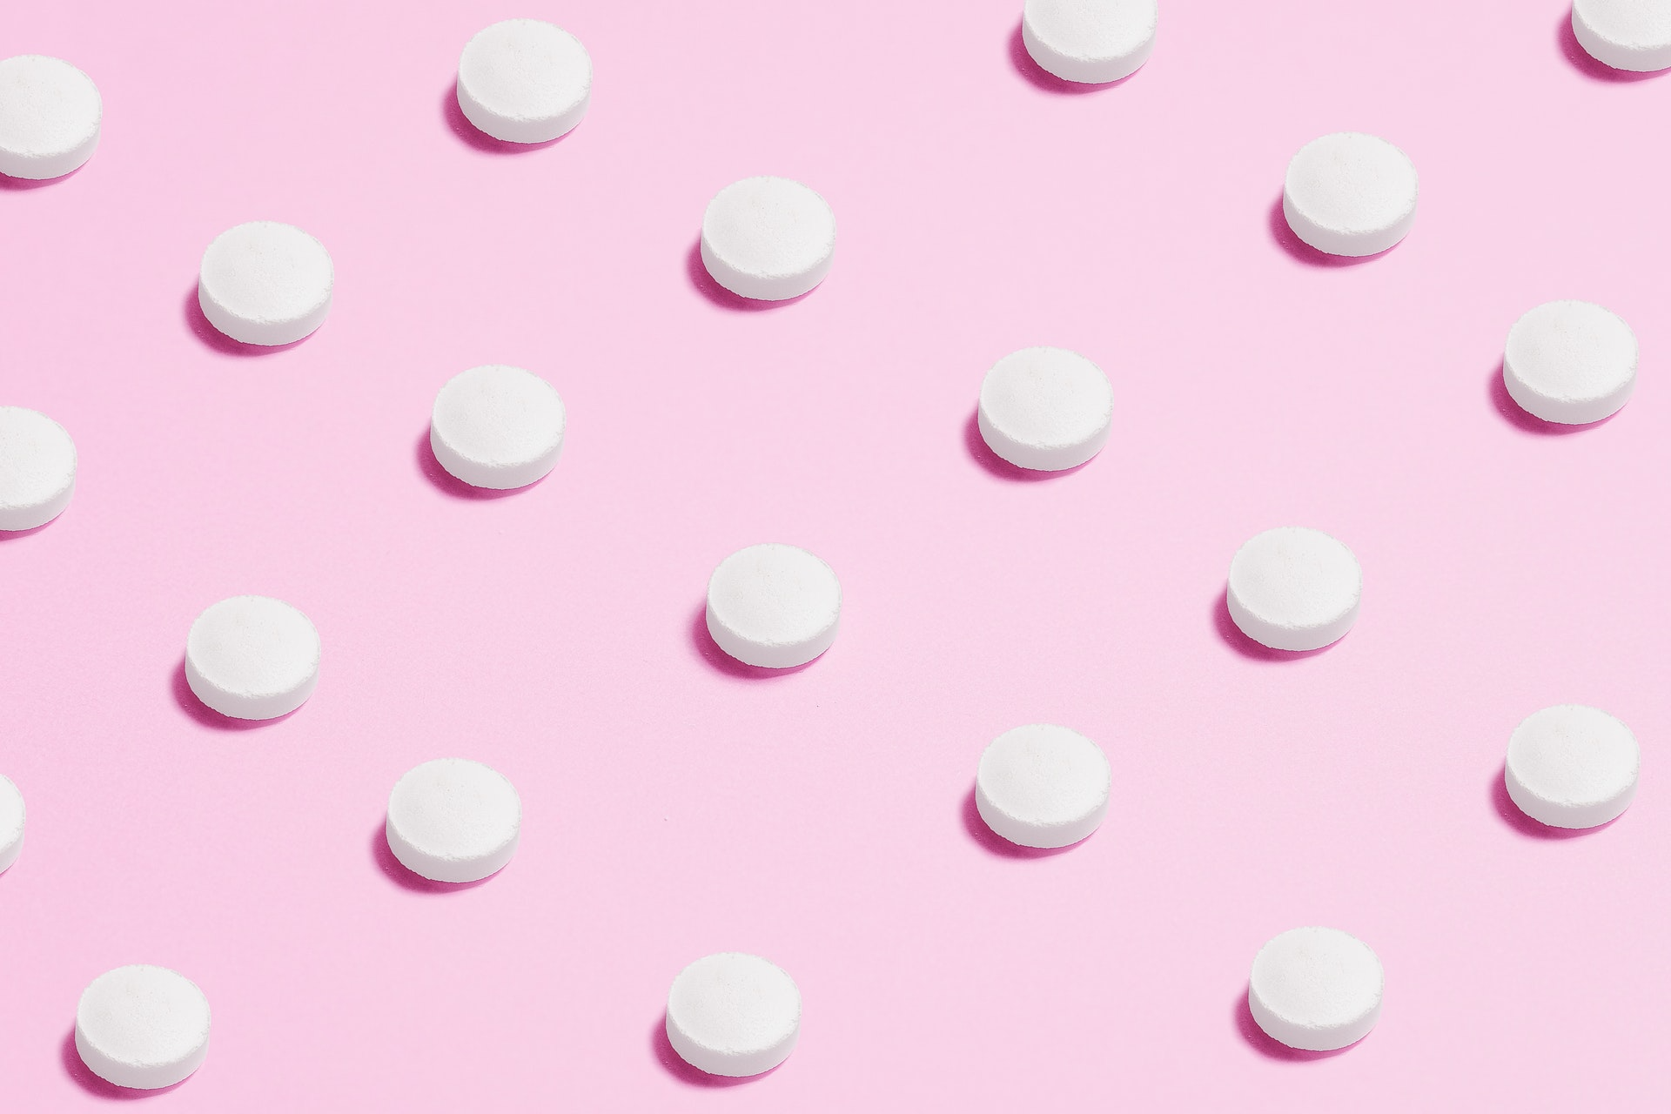
Deep Learning
9/10 things you do are errors/wrong
What are the top mistakes in Deep Learning? — AI Show
https://www.youtube.com/watch?v=4G80eRhXRHE

Slide 4
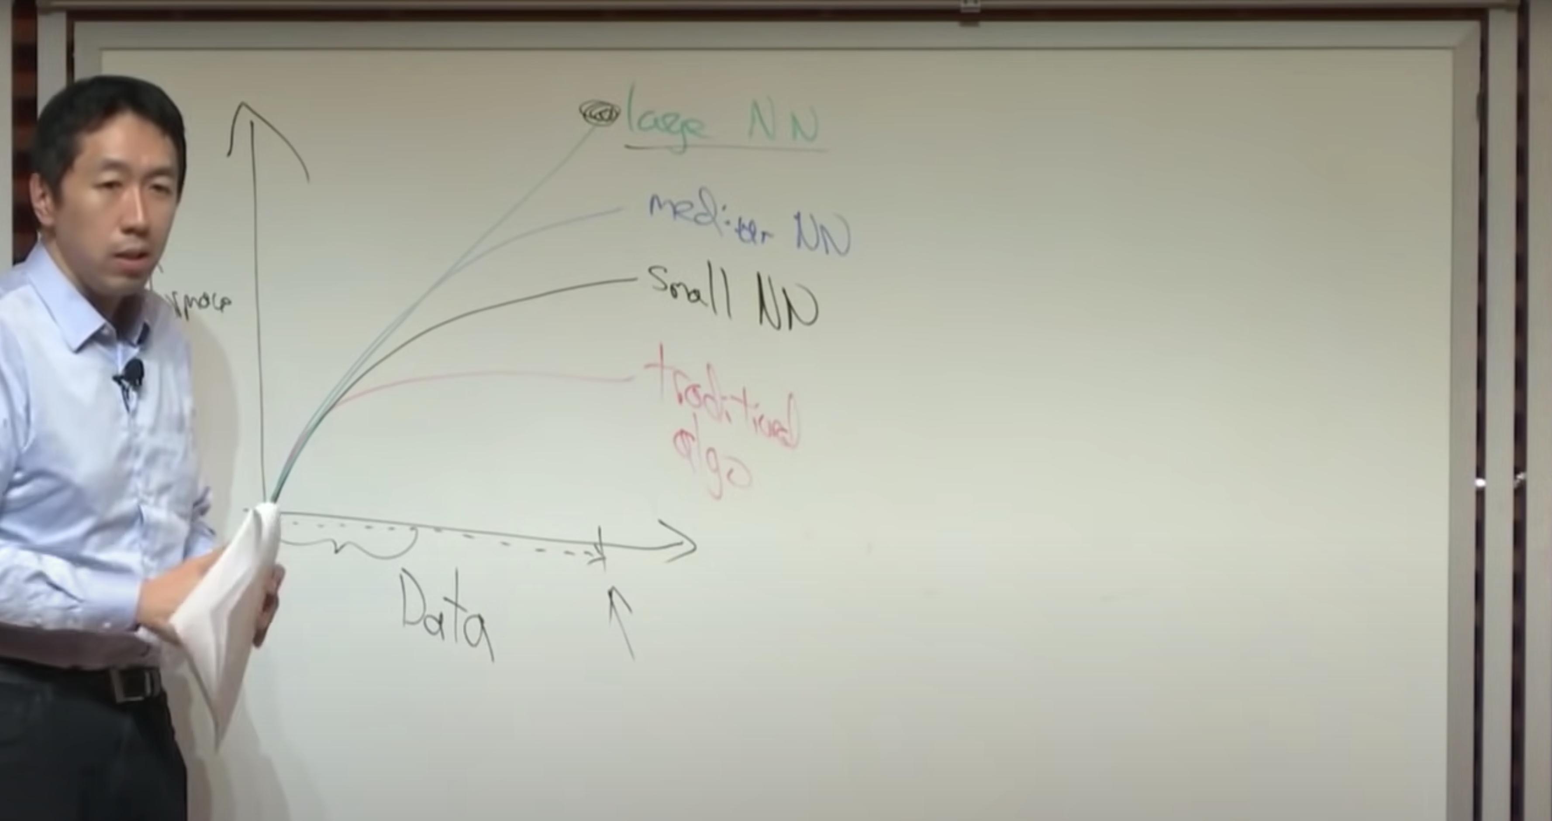
Who is more motivated to hand engineer features will do better
Nuts and Bolts of Applying Deep Learning (Andrew Ng)
https://youtu.be/F1ka6a13S9I?t=178

Slide 5
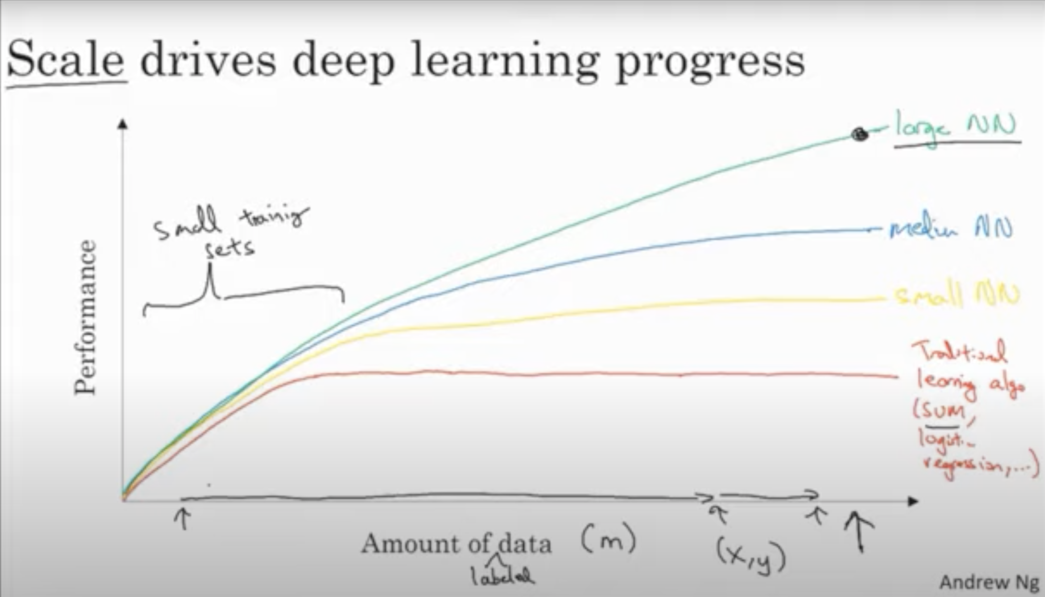
Scale drives Deep Learning Progress
Deep Learning benefits from large amounts of data,
it can absorb and keep learning from new input,
where traditional models plateau https://youtu.be/xflCLdJh0n0?t=285

Slide 6
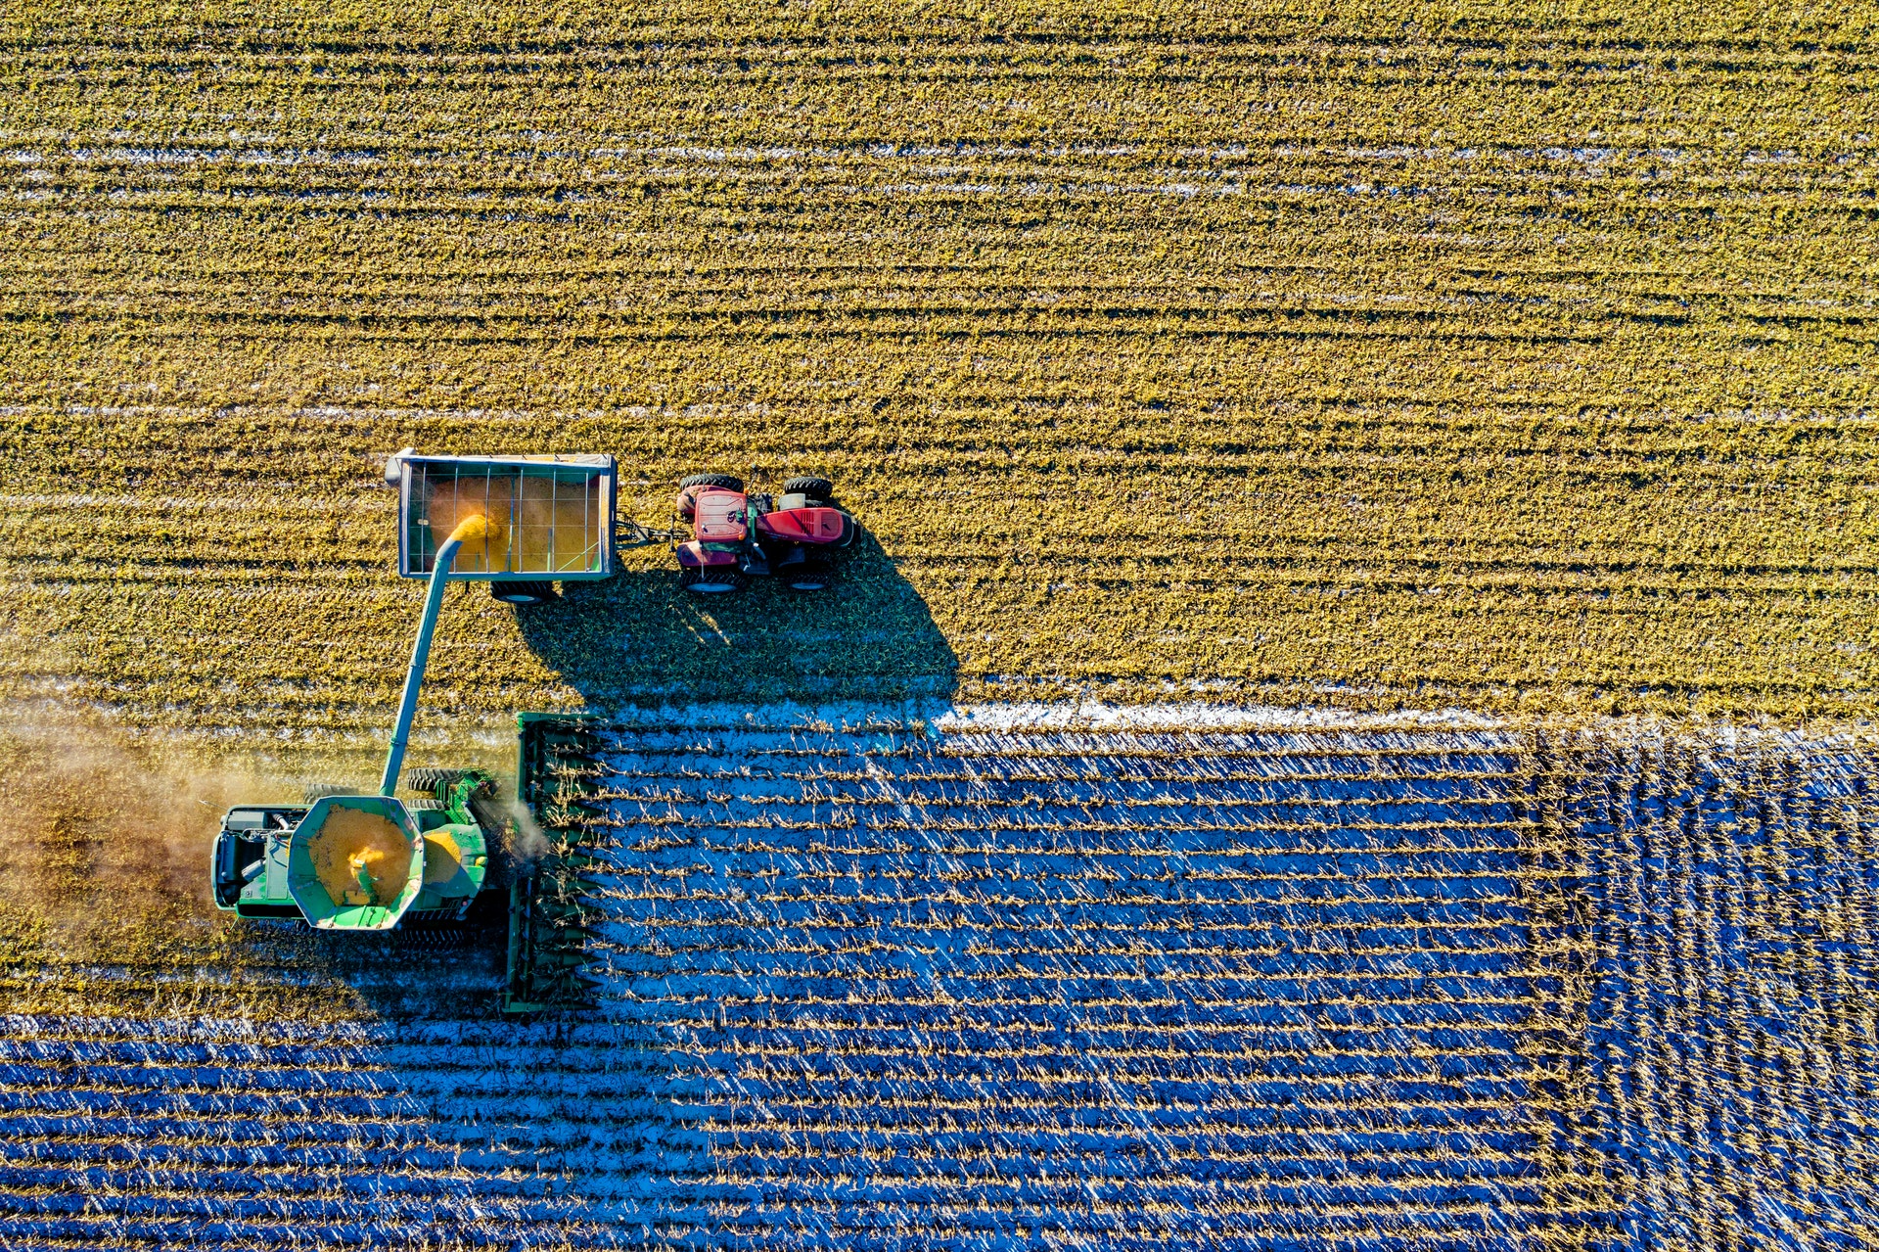
Can you Apply Transfer Learning?
Yeah Baby Yeah!!!
Jasper Derikx – But he didn’t actually use those words…

Slide 7

Be careful…
No Guarentee to work
Erik Jan de Vries – But the picture is a random person from pexels.com

Slide 8

Text & Images: Deep Learning
For tabular: Gradient Boosters,
TimeSeries: Maybe… but first…
Robbert van der Gugten A nice example is the StarSpace model I used at Randstad in comparison to matrix factorization.
Embedding comparison with the StarSpace model made it possible to do quick prediction for new data points.

